Slide 1

2025 SE Term Project
2025-06-06
Team 2
정인혁, 권재민, 김진하, 이민규, 최정우

Slide 2
Content
Development Process
Requirement Elicitation
Design
Test
GitHub

Slide 3
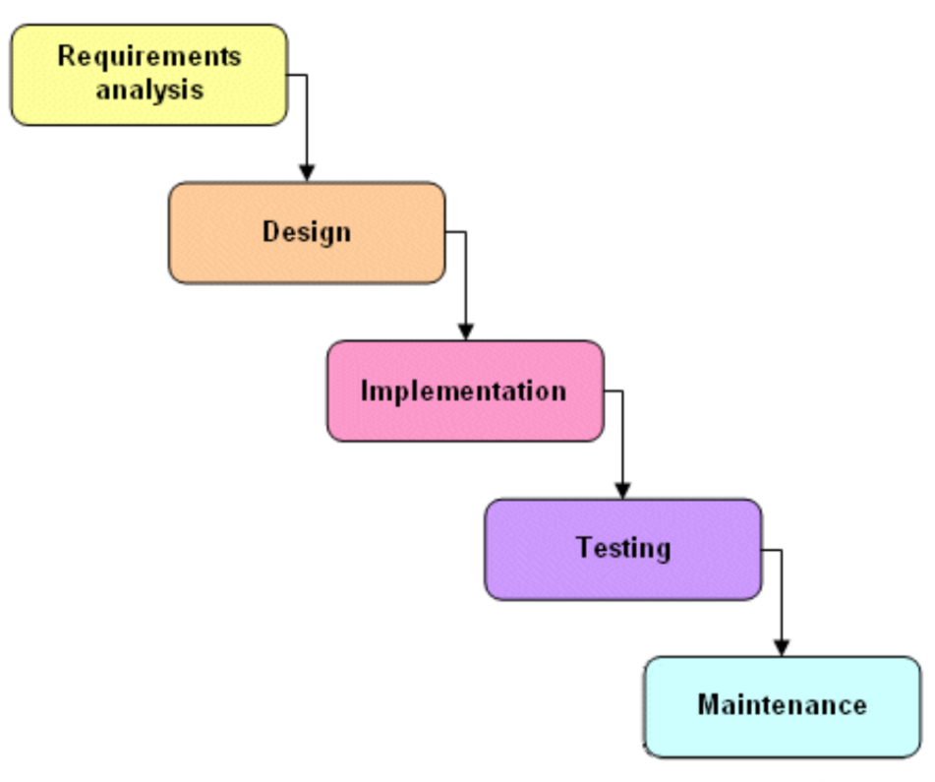
Development Process
Waterfall model
Advantage
Cleanly divide the problem into distinct phases
Disadvantage
Requirements can be specified and frozen early
Requirement bloating
Enable efficient development because requirement is not changed

Slide 4
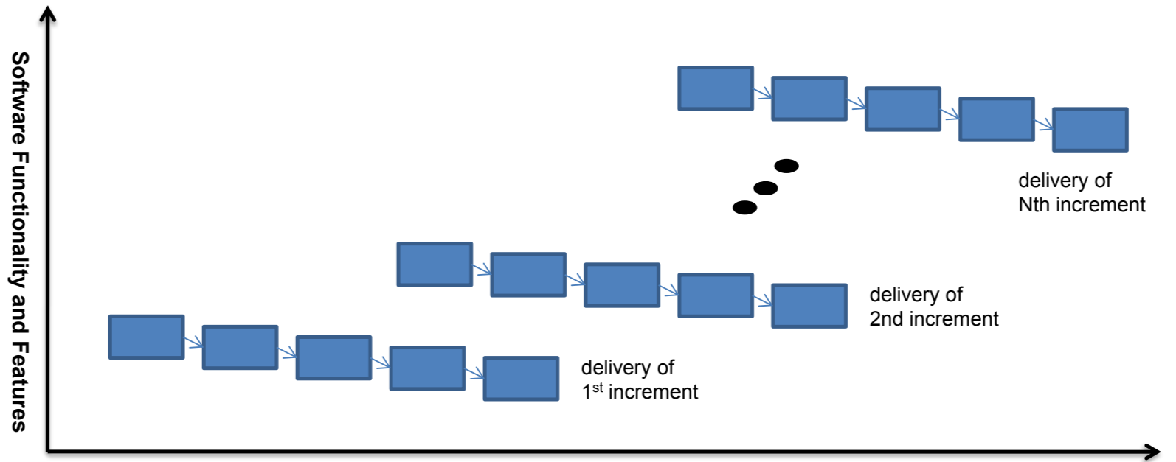
Development Process
Agile model
Advantage
Risk reduction
Flexibility to modifications
Disadvantage
Architecture/Design may not be optimal
Rework may increase
A quick response is possible when requirement is changed

Slide 5
Development Process
Our development process
Agile model
May have missed requirements
Pentagon, hexagon need to be renewed

Slide 6
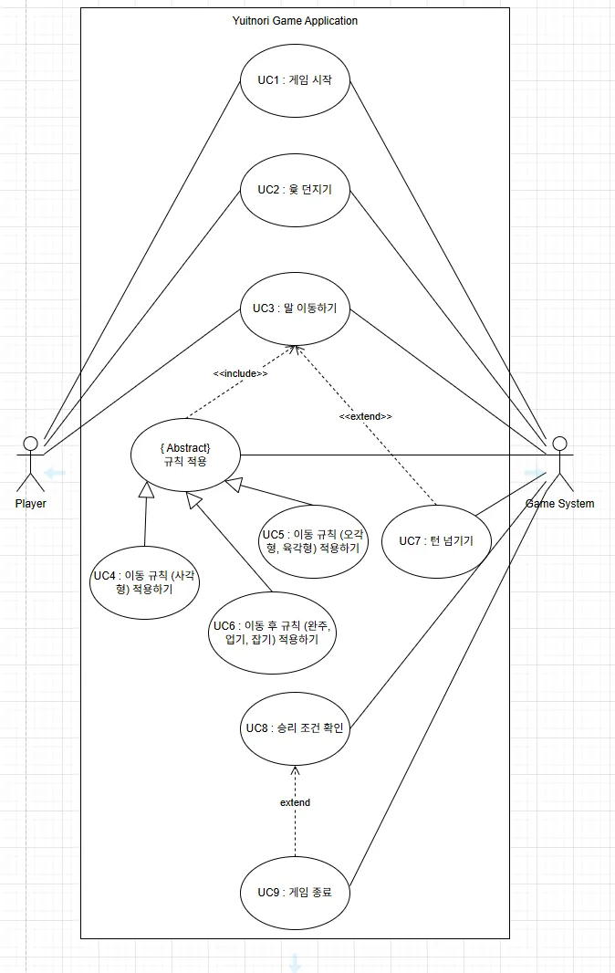

Requirement Elicitation
Use case
Define 9 use cases
$e.g.,$UC1 : 게임 시작, UC2 : 윷 던지기, … UC9 : 게임 종료

Slide 7
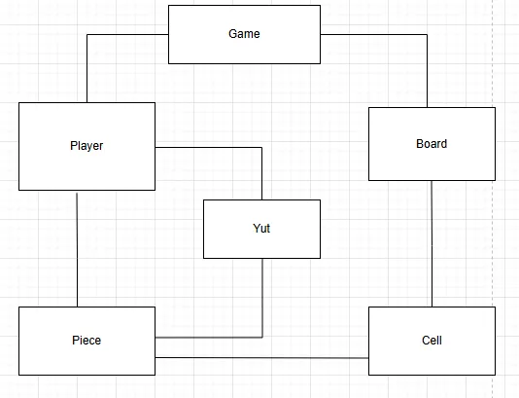

Requirement Elicitation
Domain Model
1. Find conceptual classes
Reference noun phrases in the use cases
$e.g., 게$임 시스템 $→$Game, 플레이어 $→$Player
2. Draw the identified conceptual classes in a UML class diagram

Slide 8
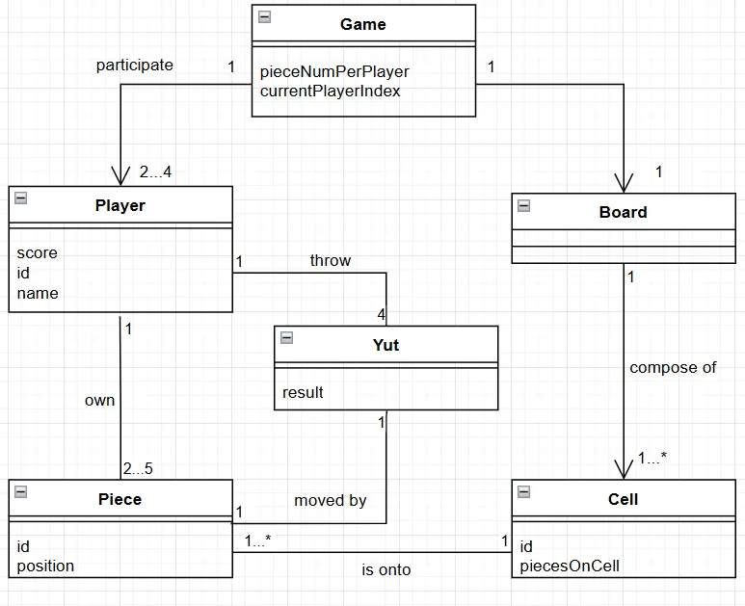
Requirement Elicitation
Domain Model
3. Add associations and attributes to conceptual classes

Slide 9
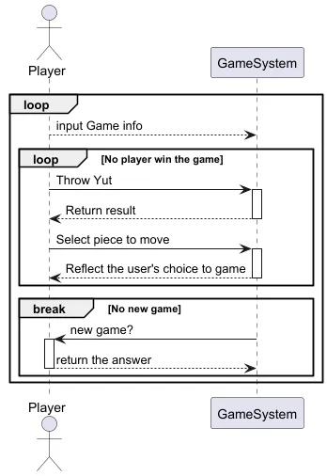
Requirement Elicitation
System Sequence Diagram
Consist of the interaction between Player and GameSystem

Slide 10
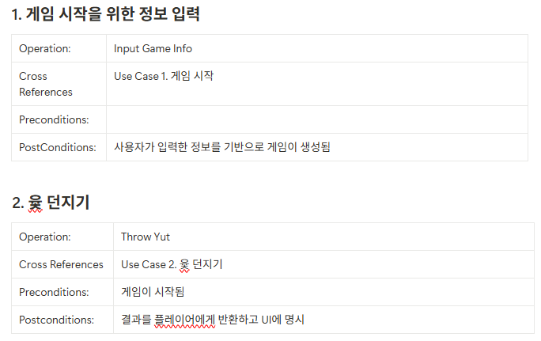
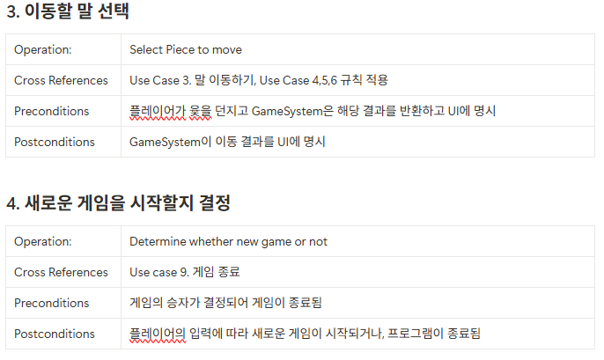
Requirement Elicitation
Operation Contract
User’s action
Input Game info
Throw Yut
Select Piece to move
Determine whether new game or not

Slide 11
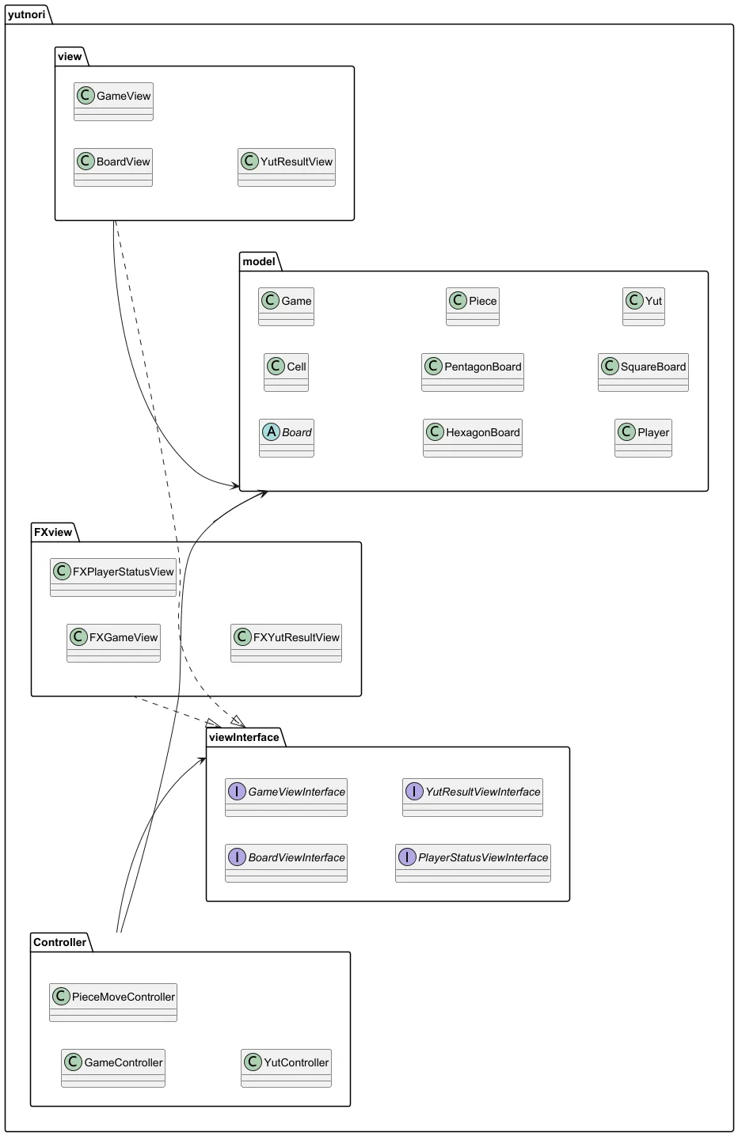

Design
MVC Model
Minimize modification of existing code by adding new UI toolkit
$→$ Introduce Interface-based design

Slide 12
Design
MVC Model
Model
Store information on objects constituting the game
ViewInterface
Abstraction of UI Layer
View, FXView
Implement Swing and JavaFX-based GUIs, respectively
Controller
Process user input and link Model and View

Slide 13
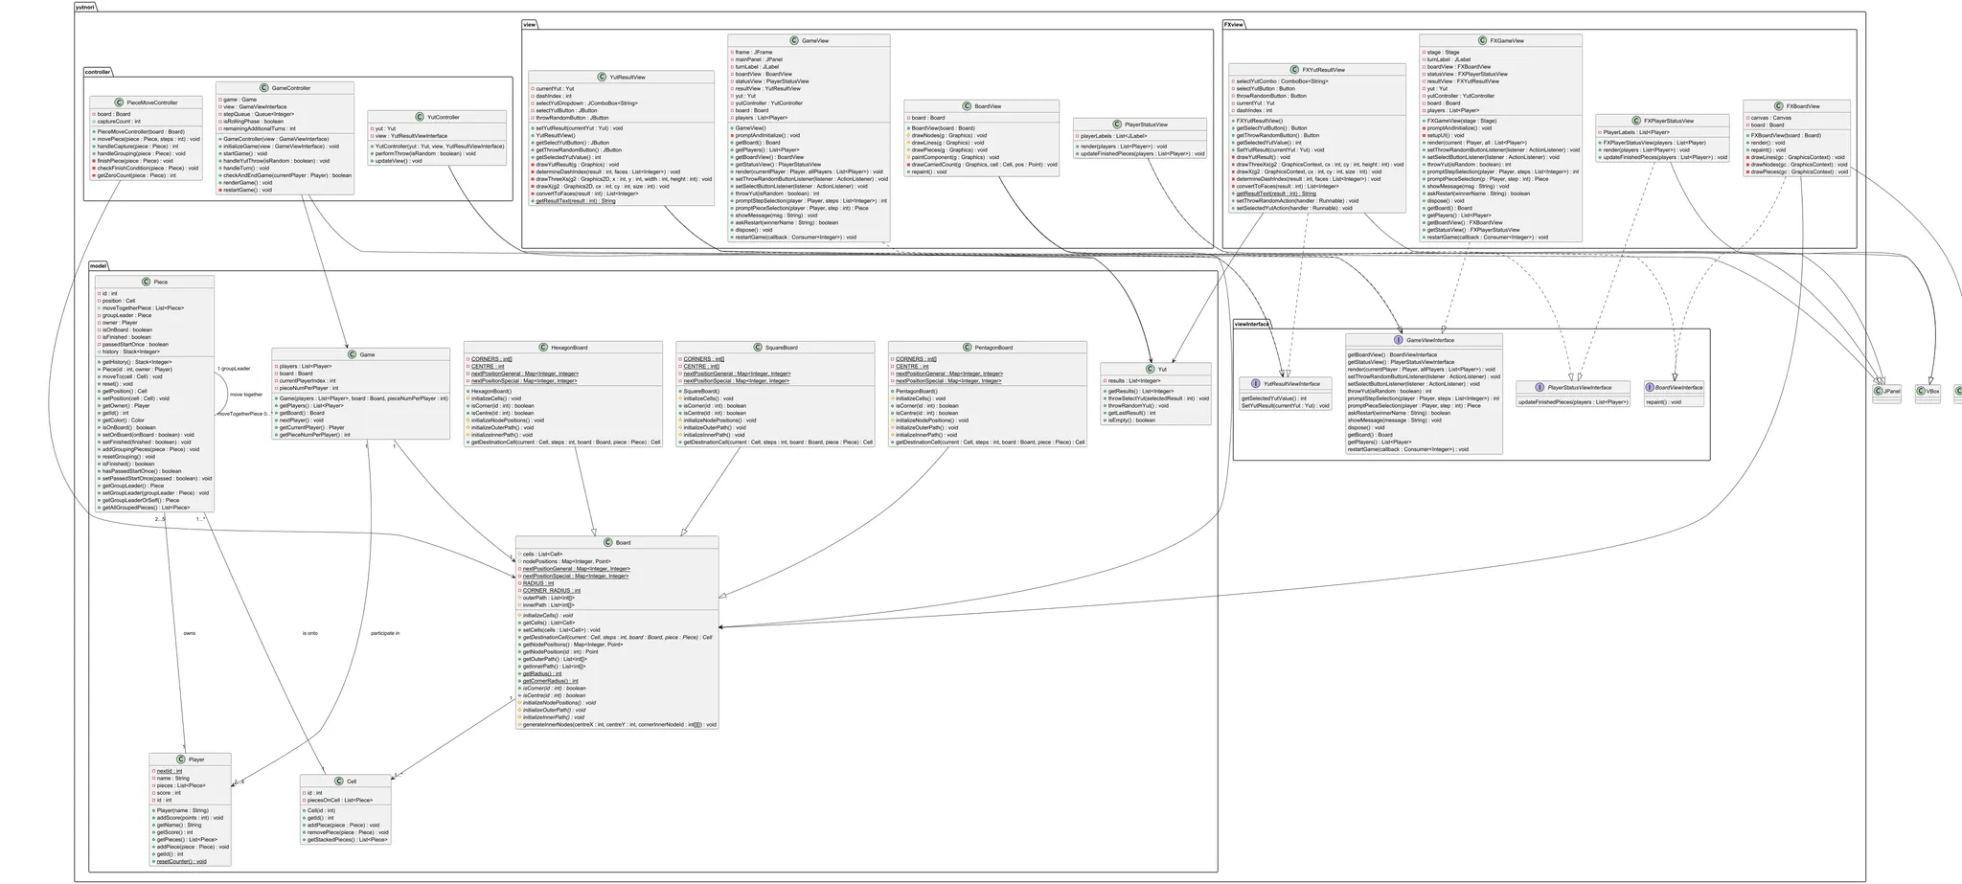
Design
Class diagram
Reflect SOLID principle

Slide 14
Design
Sequence diagram

Slide 15
Test
Test range
Model
Board, Cell, Player, Piece, SquareBoard, HexagonBoard, PentagonBoard
Controller
GameController, PieceMoveController, YutController
View
Manually validated through direct execution

Slide 16
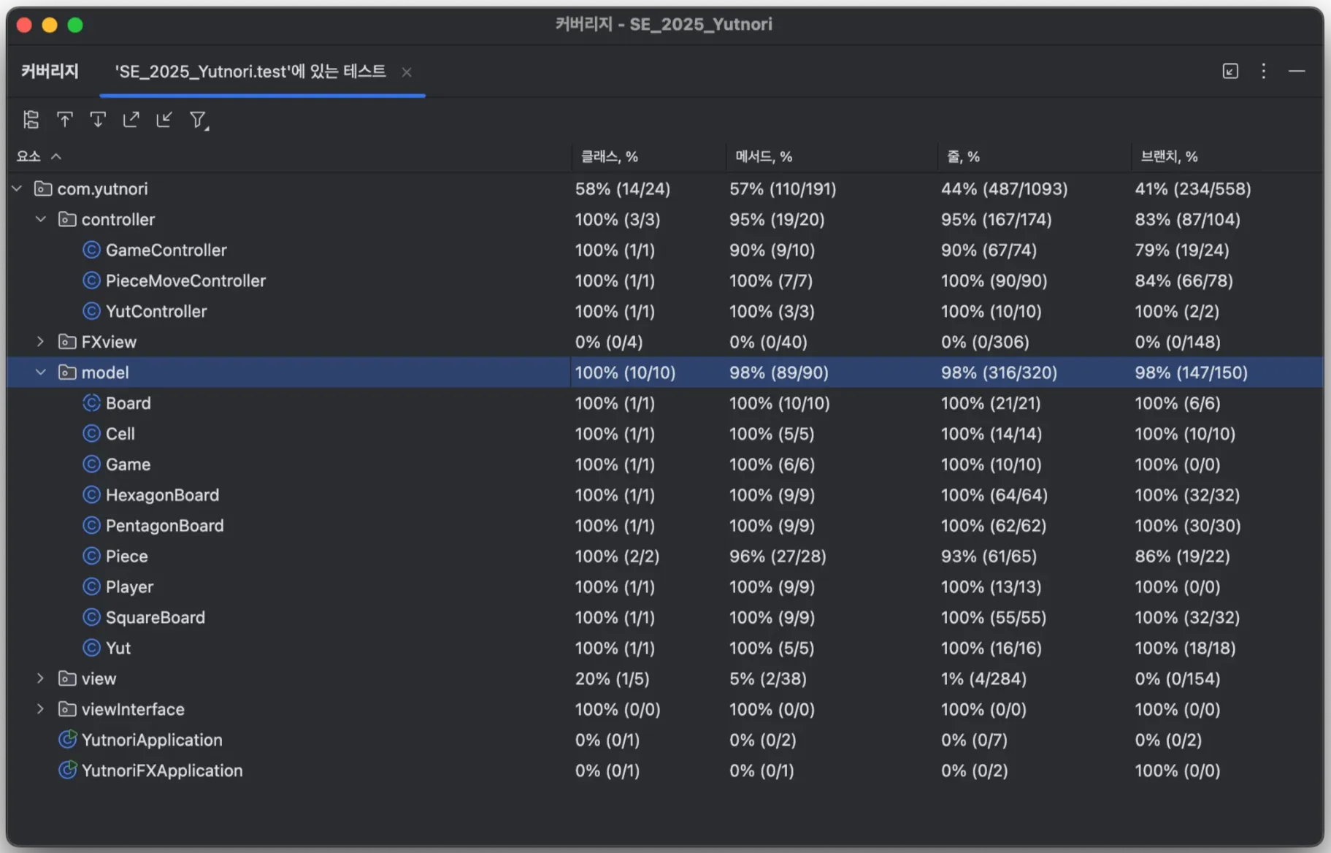
Test
Coverage results
Model
Class : 100%
Method : 98%
Line : 98%
Branch : 98%
Controller
Class : 100%
Method : 95%
Line : 95%
Branch : 83%

Slide 17
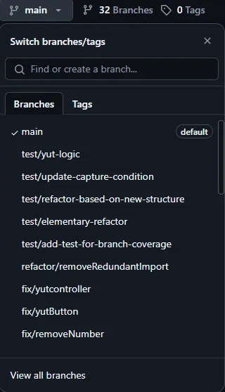
GitHub
Branch
Based on GitHub Flow
Structure
Main
Branch for final submission
Develop
Merge here after functional develop
Feature, Fix, Test, Refactor/기능명

Slide 18
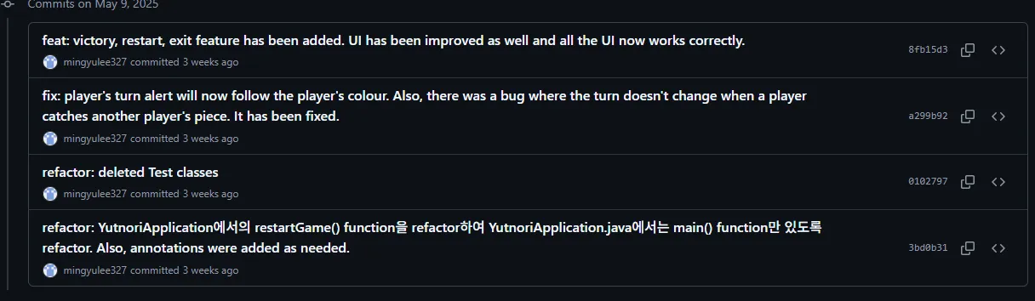
GitHub
Commit Convention
Commit Rule
Action : Description

Slide 19
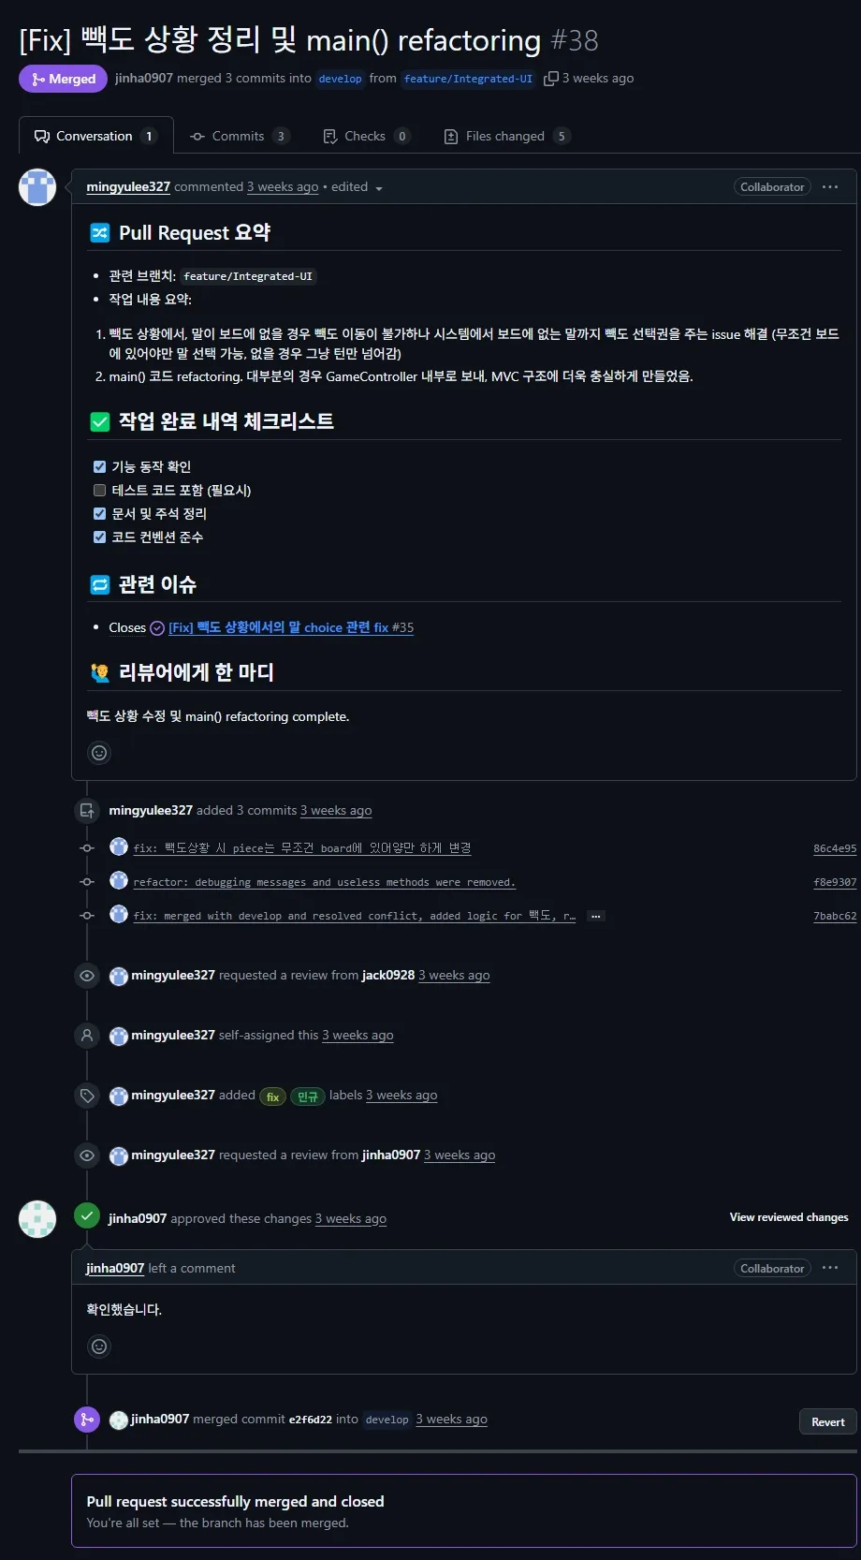
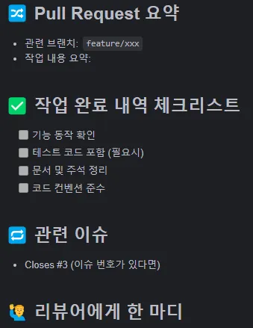
GitHub
Pull Request
PR Template

